Slide 1
Mobile Marketing:
How to Fix the 7 Costly Mistakes You’re Most Likely Making

Slide 4
Joe Reuth
Builder Marketing Edge
Director of Digital Marketing
joe@buildermarketingedge.com
941-404-6848

Slide 5
Here’s Where We Are
In 2018, 58% of website visits were from mobile devices (phones & tablets)
Mobile devices made up 42% of total time spent online
Majority of mobile use time is spent using apps
From Similar Web and reflect U.S. traffic across the web
Worldwide Mobile Device Share

Slide 6
U.S. vs World Usage – IOS Almost Same

Slide 7
Tablet Share in U.S. - It’s All About the iPad

Slide 8
Search Engine Market Share in U.S.
Besides Android devices, Google is the default search engine for iPhones and iPads

Slide 9
The Mobile World is Google’s World
Mobile search traffic – Google drives 96% of mobile search in U.S. Google Search is also one of the most popular mobile apps in the U.S. Source: NetMarketShare
Google drives 95% of all paid search ad clicks on mobile Source: Search Engine Land
To maintain or improve your search engine presence, and since mobile is now dominant and growing, you must know what Google wants on mobile, and you must give them what they are looking for.
The good news is that when you implement what Google wants, you will have a competitive advantage versus other builders who don’t.

Slide 10
Your Customers Live in a Mobile First World
Google indexes the mobile experience first
Why?
Because they can
Most searches are on mobile
Location data gives more relevant results

Slide 11
Mistake 1: Google My Business for Each Community Set Up Properly

Slide 12
GMB Elements
Your GMB listing affects:
Search page rankings
Google Maps results
“Near me” searches
Done properly, when prospects are searching for a new home community in their area of interest, your community will show in the top 3 results.
However, many communities are either not listed, or are set up improperly so that they don’t rank.

Slide 13
Why? GMB Profile Drives Google Traffic
GMB Result
Google Maps Result

Slide 14
Google Maps Results
Search term:
New Homes Avon Lake
Search term:
Community Name

Slide 15
Problem: how do I get new communities listed in GMB?
One of the challenges to getting new communities on GMB is that when you do not have a model home built yet, you can’t verify the GMB listing by mail as Google prefers.
>>Actionable Strategy
Add your new communities to Google Maps and use the map pointer to designate where the community will be, and add the new address for the model home.
Then, in about 30 days do a search for your community name + city and state on Google search and you will likely see a shell of a listing appear for the community.
Then, claim the listing and fill out the rest of the GMB profile.

Slide 16
GMB Continued
>>Actionable Strategy
Customer reviews determine which communities rank higher. Encourage your happy buyers to leave reviews.
This not only helps with social proof but improves your mobile search rankings.
>>Actionable Strategy
If you are not doing off page SEO on your communities, such as adding them to data aggregators and building local links to each community, you should look into this. More local signals = more trust in Google’s eyes.
Off page SEO will give you a boost over your competitors – important if you are in a very competitive market.

Slide 17
Mistake 2: Not Using Proximity Marketing Ads
This is a must do for every home builder. You need to dominate the marketing where your communities are and make sure you are one of the communities that prospects visit.
Google Ads for Mobile Problem: using a one bid fits all strategy
>>Actionable Strategy
Increase your bids (which should increase the likelihood of your ad being served) as prospects are closer to your model centers or competitor’s model centers

Slide 18
Proximity Marketing Ads on Google Maps
Searches on Google Maps are exploding.
Google Maps is 6 TIMES more popular than other navigation apps.
Yet many builders are not advertising here.
>>Actionable Strategy
You should have location extensions enabled on display ads, which will show your community address and allow your ads to show in Google Maps.
If it is within your budget, you should run ads on Google Maps, as these prospects are actively in the market touring homes.

Slide 19
Mistake 3: Not Using Geofencing Where Appropriate
Geofencing for mobile is the use of GPS location data on mobile devices to create a virtual boundary around a desired location.
Those present in the desired location can be targeted with ads for a number of days.

Slide 20
Serve ads while they are there or up to 30 days, or shorter or longer if your want, after they leave that location.
Will see your ads when on apps or on websites with advertising space.
Ads can be banner, special offers, video ads.
>>Actionable Strategies
Target model homes at competitor communities
Target apartment complexes for first-time home buyers/millenials
Target “feeder” communities where your future buyers reside
Target select employers in areas near your communities

Slide 21
Geofencing Continued
Results are trackable; you can tell if someone responding to your geo-fence target actually walks into your model center.
You are putting your ad in front of someone who did not originally inquire about your product.
Can be expensive: approximately $30 per conversion
Very few builders are doing this – you will gain a competitive advantage and have a new lever to pull when you need additional model center visits.

Slide 22
Mistake 4: Email Not Mobile User Friendly

Slide 23
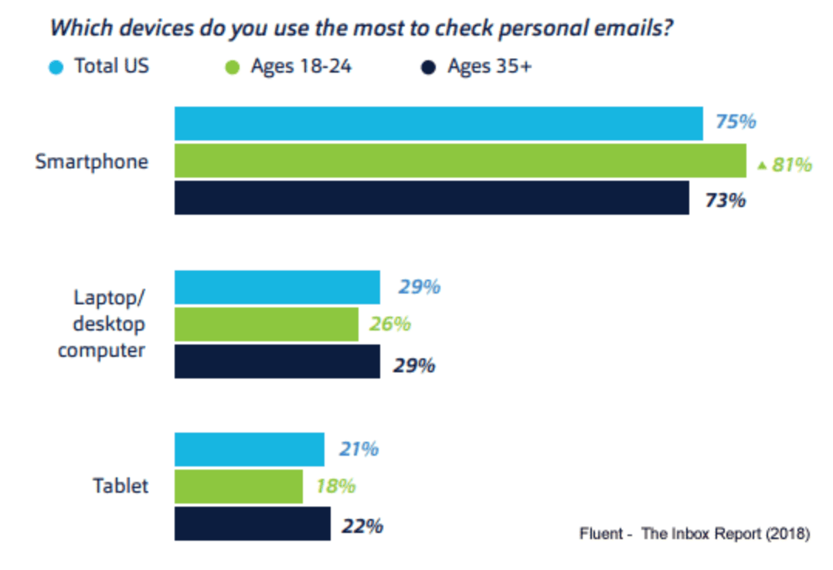
Emails are opened more often on mobile than desktop.
Exception: many real estate agents open emails more frequently on desktops – up to 60%+

Slide 24
Mobile Friendly Email Best Practices
Emails that display incorrectly on mobile are usually deleted within 3 seconds.
Preview your emails in mobile and tablet modes to make sure they are formatted properly.
Responsive email is not the same as email user friendly – just because the email is responsive does not make it user friendly.

Slide 25
DO’S AND DON’TS
Don’t put Calls to Action low in email; ideally should be above or near fold
Don’t use Oversized images
Don’t use a wall of text without breaks; something that’s two or three lines on a desktop computer could up being ten lines on a 4-inch smartphone screen.
Do use alt text (for when internet connection is poor)
Do use buttons instead of links for easier usability
Do keep subject lines short and to the point, as mobile devices cut down the number of characters seen in the subject line. The same can be said for your preheader text as well.
Do keep your message concise: remember, your readers want to know the important information right away, and because they are viewing this on a much smaller screen, they don’t want to be scrolling to find the valuable stuff.

Slide 26
Mistake 5: Not Optimizing User Experience For Mobile First
Why should you do this?
Most of your potential new customers are searching from their mobile devices.
Google is now using a mobile first index.
The cost of not doing so means not showing up ahead of competitors in searches AND users abandoning your website because of poor load time.
>>Actionable Strategy
Text size – is it large enough to be easily read on mobile phones? Searchers no longer want to “pinch and zoom”.

Slide 27
>>Actionable Strategy
Is your call to action button high up on the page, ideally above the fold? The placement of the button is crucial to click ratios, without having to scroll.
Unfortunately, you could have the best image or video in a marketing campaign, but without a call to action your audience will most likely leave after glancing at the image or watching a second of the video.
>>Actionable Strategy
Google has ruled that POP UPS have to go.
Any website leveraging “intrusive interstitials” that hinder the users’ ability to access content on the page will not rank as highly.

Slide 28
Google describes interstitial/popup techniques that are penalized like this:
Showing a popup that covers the main content, either immediately after the user navigates to a page from the search results, or while they are looking through the page.
Displaying a standalone interstitial that the user has to dismiss before accessing the main content.
Using a layout where the above-the-fold portion of the page appears similar to a standalone interstitial, but the original content has been in-lined underneath the fold.

Slide 29
>>Actionable Strategy
NOW is the time to view your website from your mobile device and be truthful how mobile friendly your site really is.
Then, make plans to make the necessary fixes.

Slide 30
Mistake 6: Slow Page Speed Load Times
Page Speed is a Ranking Factor for BOTH Google Search and Google Ads

Slide 31
Give Google What is Wants and Rank Higher!
Google want/demands fast loading websites and penalizes sites that are slow.
Two areas that cause pages to low slowly:
Too much JavaScript
Too many images and not compressing images
BONUS: Fast loading webpages have a higher conversion rate!
>>Actionable Strategy
Google provides a tool to check your site’s speed, and each of your community pages. Use this tool!
Google Mobile Page Speed Insights Tool
https://developers.google.com/speed/pagespeed/insights/

Slide 32
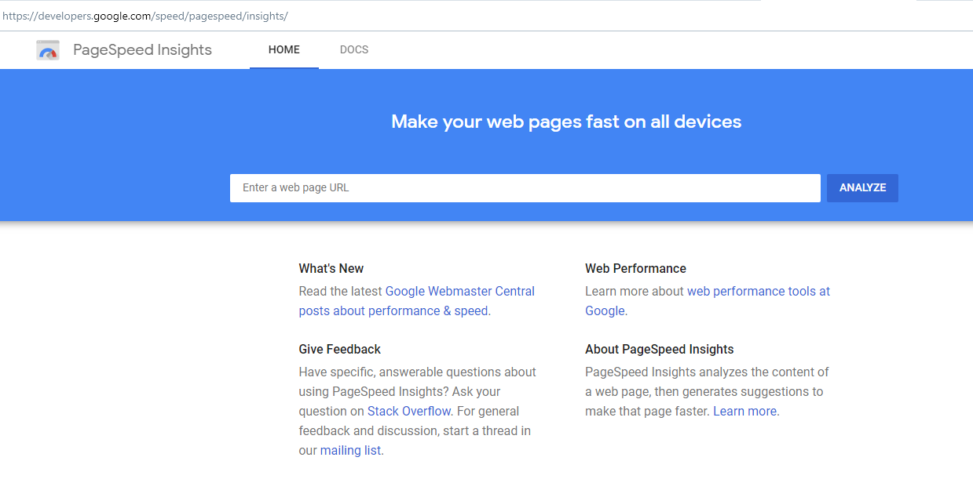
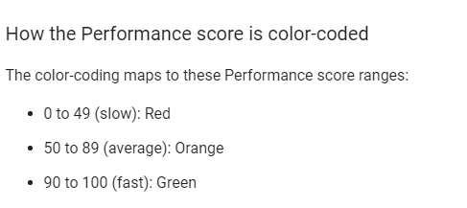
Mobile Page Speed Insights
https://developers.google.com/speed/pagespeed/insights/

Slide 33
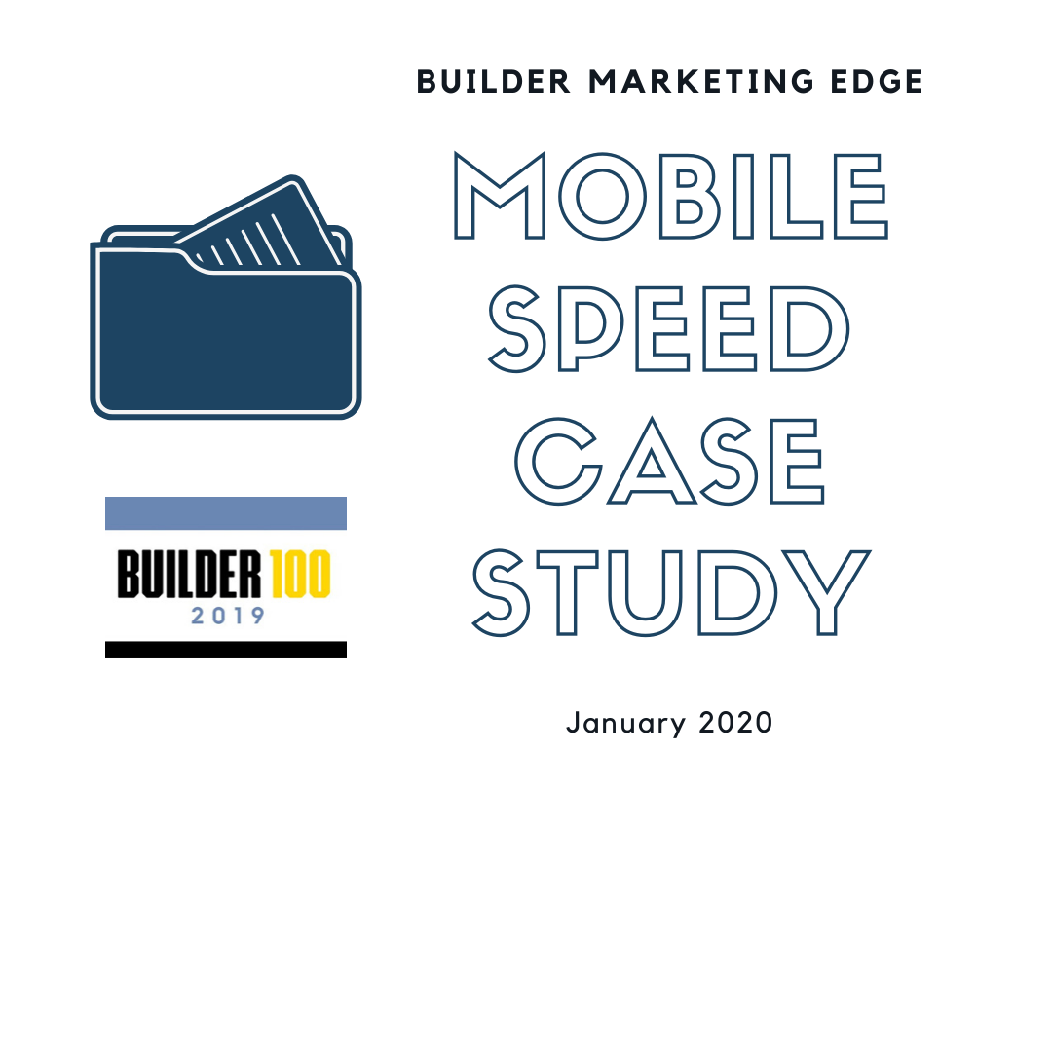
There is a BIG Opportunity Here
Builder Marketing Edge Case Study of Top 15 Builders from the Builder 100
10 builders’ websites deemed VERY SLOW by Google, each below 25 score
Only 5 builders above 25 score
Only 1 builder above 50 (average speed)

Slide 34
Page Speed Results for Home Page

Slide 35
Mistake 7: Not Taking Action
Now is the time to incorporate your mobile marketing with 2020 best practices.
You have an opportunity to:
Improve your GMB page to rank higher on Google searches and Google Maps searches
Improve your paid ad visibility through proximity targeting
Use Geofencing to proactively drive customer traffic – this is BIG!
Get more opens and clicks from your emails
Improve your mobile user experience to avoid customers bailing on your site
Rank above your competitors’ communities by having fast loading pages

Slide 36
Joe Reuth
Builder Marketing Edge
Director of Digital Marketing
joe@buildermarketingedge.com
941-404-6848

